Slide 1

Module 11:
How do I get the weather forecast without a browser?
CoTaPP: Computational Thinking and
Programming with Python
All icons by: https://www.flaticon.com/

Slide 2
Module 11:
Remote Resources
CoTaPP: Computational Thinking and
Programming with Python
All icons by: https://www.flaticon.com/

Slide 3

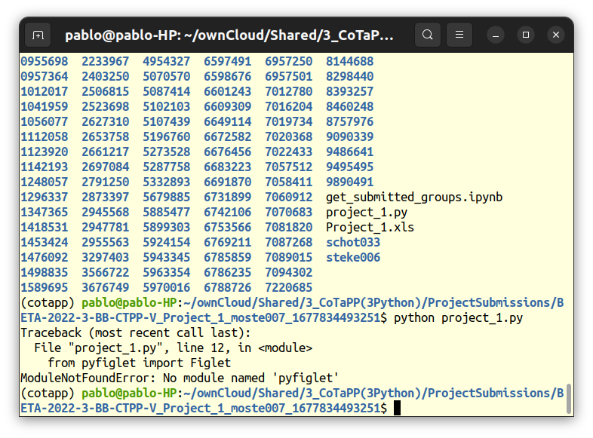
Project 1 review
Notes:
No comment about requirement in project documentation

Slide 4
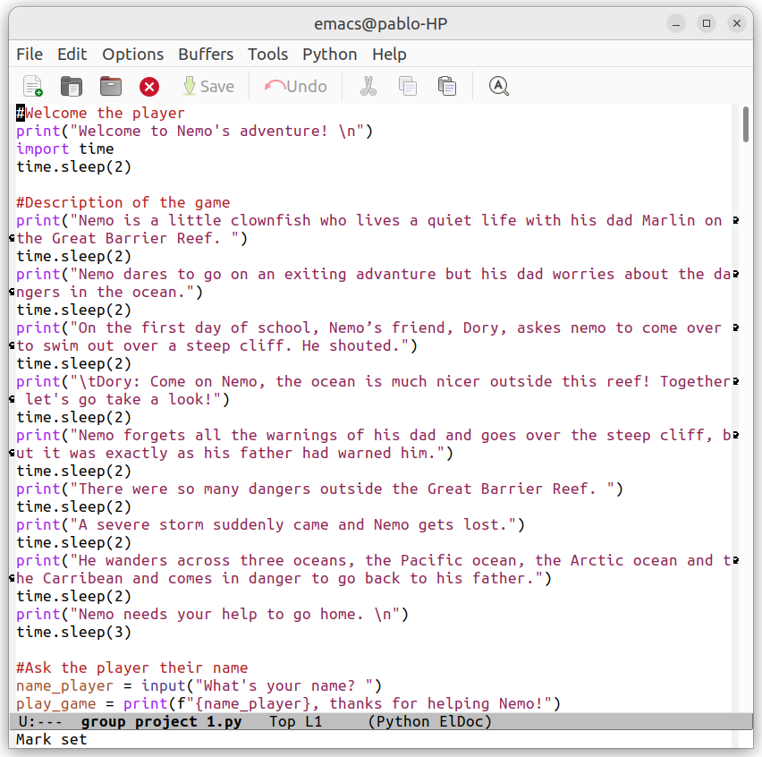
Project 1 review
Notes:
No modularization

Slide 5

Project 1 review
Notes:
5 Wooclap questions, then back here

Slide 6
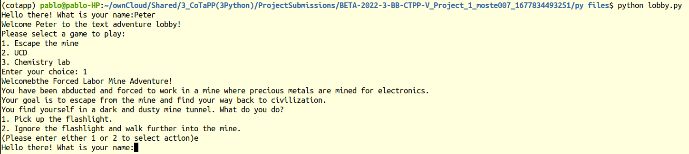
Project 1 review
No error or warning is reported to screen
Notes:
No obvious exit. Could have allowed a maximum number of attempts

Slide 7
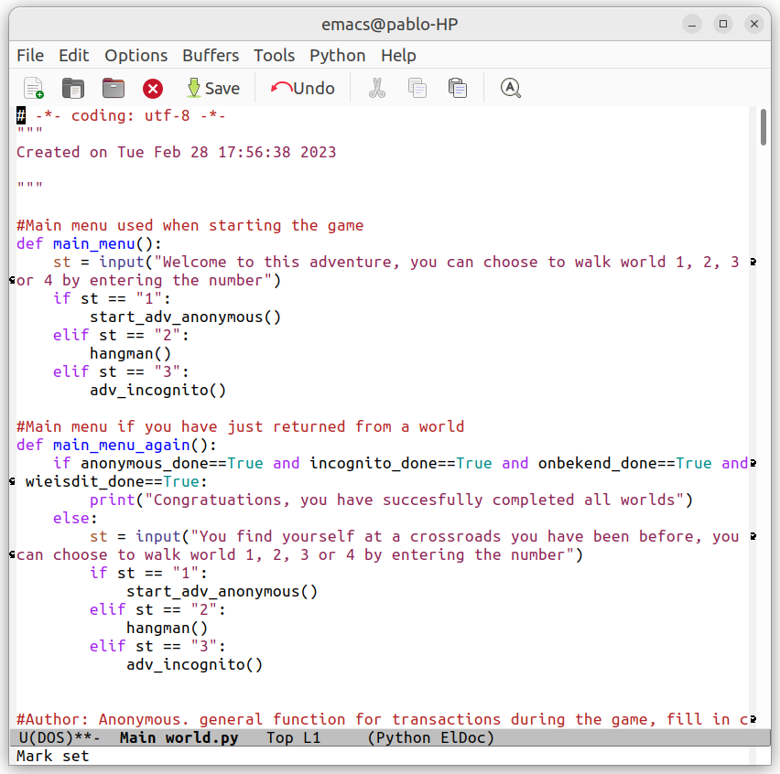
Project 1 review
Notes:
No obvious exit. Could have allowed a maximum number of attempts

Slide 8
Project 1 review

Slide 9
Previous lecture

Slide 10
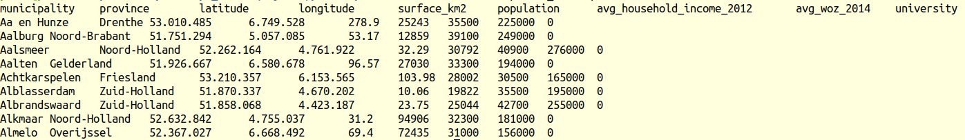
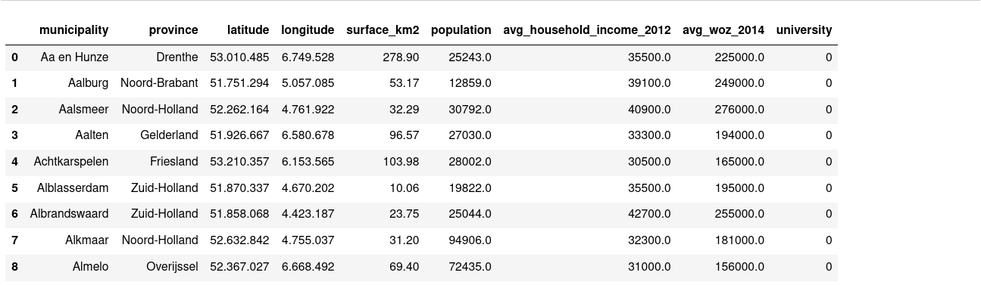
Previous lecture

Slide 11
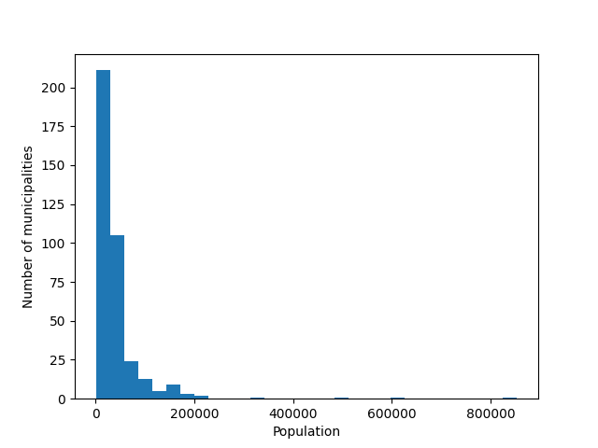
Previous lecture

Slide 12
Today’s lecture
Notes:
Question: what is missing?

Slide 13
Today’s lecture
Notes:
Question: what is missing?

Slide 14
Today’s lecture
FILE?
Notes:
Question: what is missing?

Slide 15
Today’s lecture
WWW

Slide 16
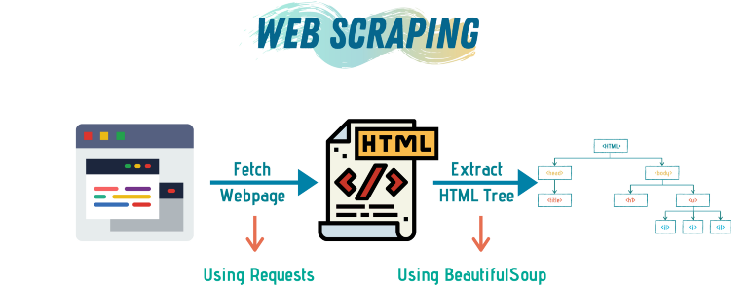
Previous lecture
https://towardsdatascience.com/a-step-by-step-guide-to-web-scraping-in-python-5c4d9cef76e8

Slide 17
Previous lecture
When/why do we need web scrapping?
https://towardsdatascience.com/a-step-by-step-guide-to-web-scraping-in-python-5c4d9cef76e8

Slide 18
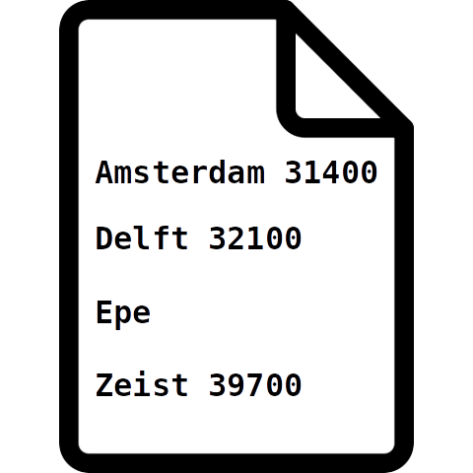
Collecting data
Notes:
Two lectures ago, we looked at the Dutch-municipalities dataset, but where do we get this dataset? Sometimes it is not available as a file, but rather in a database online.

Slide 19
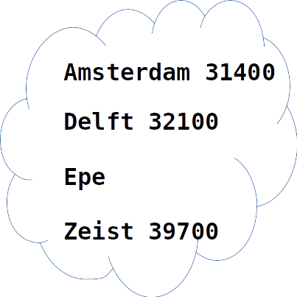
Collecting data

Slide 20
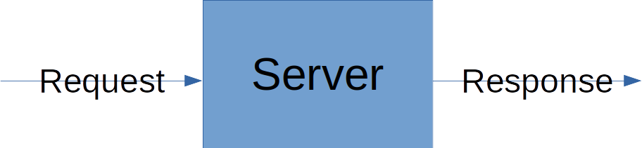
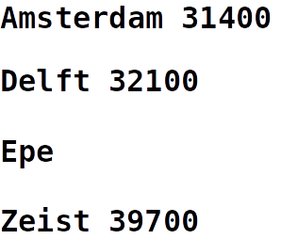
Collecting data
Notes:
Often access to these databases is provided by a server via an API, which you can send requests to, to get the data that you want.

Slide 21
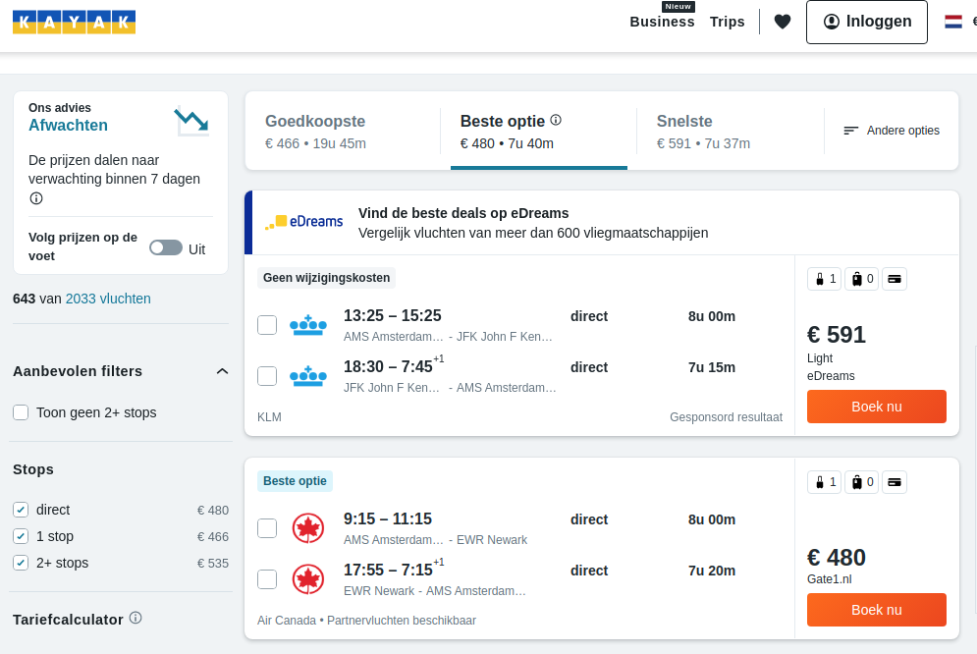
Web Scrapping projects
https://www.projectpro.io/article/web-scraping-projects-ideas/475
Flights Ticket Price Analysis

Slide 22
URL
scheme://host:port/path

Slide 23
URL
scheme://host:port/path
http://localhost:8888/tree
http://itsthisforthat.com/

Slide 24
URL
scheme://host:port/path
http://localhost:8888/tree
http://itsthisforthat.com/

Slide 25
URL
scheme://host:port/path
http://localhost:8888/tree
http://itsthisforthat.com/

Slide 26
URL
scheme://host:port/path
http://localhost:8888/tree
http://itsthisforthat.com/

Slide 27
URL
scheme://host:port/path
http://localhost:8888/tree
http://itsthisforthat.com/

Slide 28
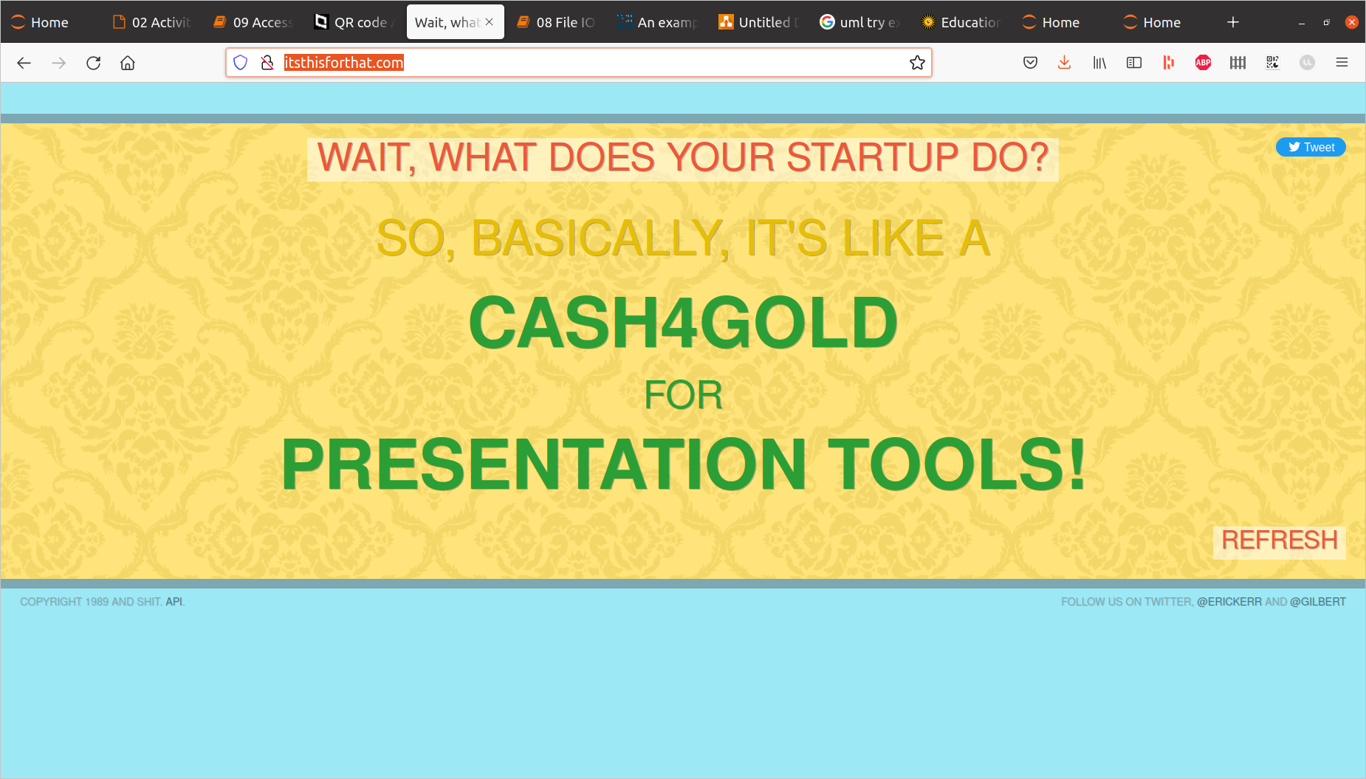
Browser Access

Slide 29
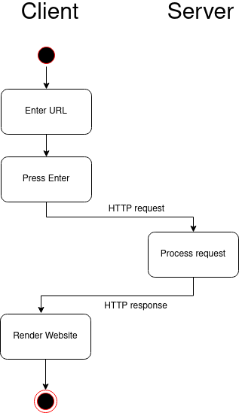
Browser Access

Slide 30
HTTP
Server
Request
Response

Slide 31
HTTP: GET

Slide 32
HTTP: GET
Server
Request
Response
Request = URL

Slide 33
HTTP: POST
Server
Request
Response
Request = URL + ...
Why would you want to send content?

Slide 34
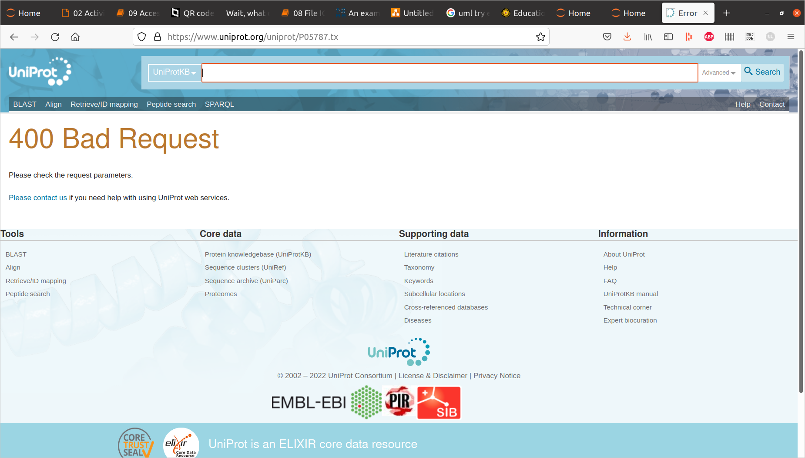
HTTP Response
* Response Code

Slide 35
HTTP Response
* Response Code:
1XX-3XX good, 4XX-5XX bad

Slide 36
HTTP Response
* Response Code:
1XX-3XX good, 4XX-5XX bad
* Response Content

Slide 37
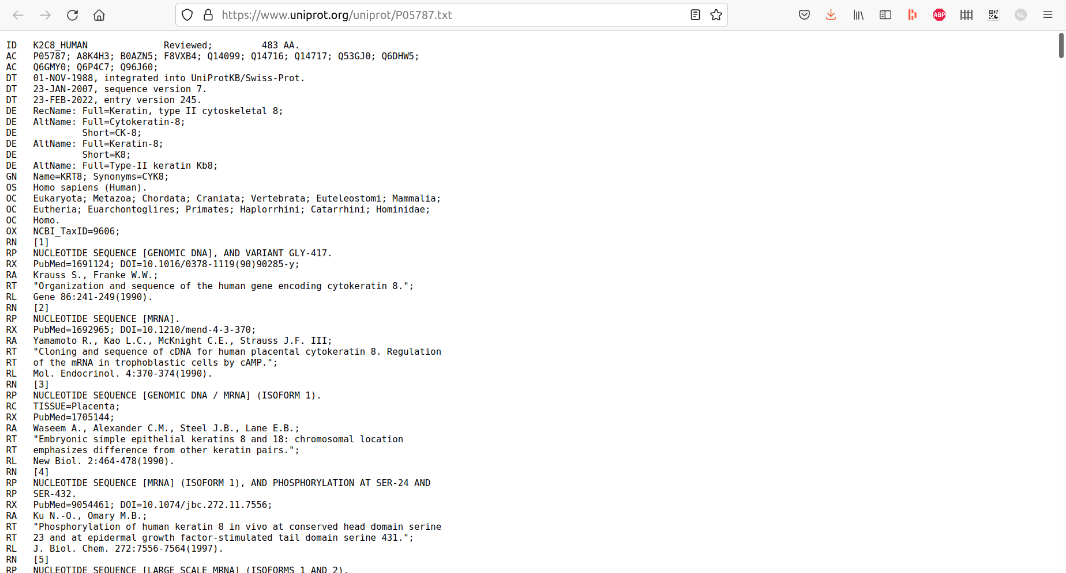
HTTP Response
* Response Code:
1XX-3XX good, 4XX-5XX bad
* Response
Content:

Slide 38
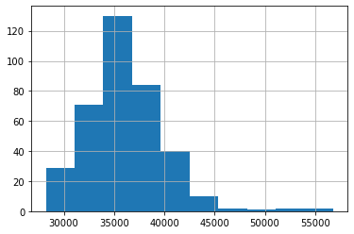
Quick Recap
You want to analyze the average household income by municipality in NL
Amsterdam 31400
Amsterdam 31400
Delft 32100
Epe
Zeist 39700
What is the remaining challenge?

Slide 39
HTTP Response
* Response Code:
1XX-3XX good, 4XX-5XX bad
* Response
Content

Slide 40
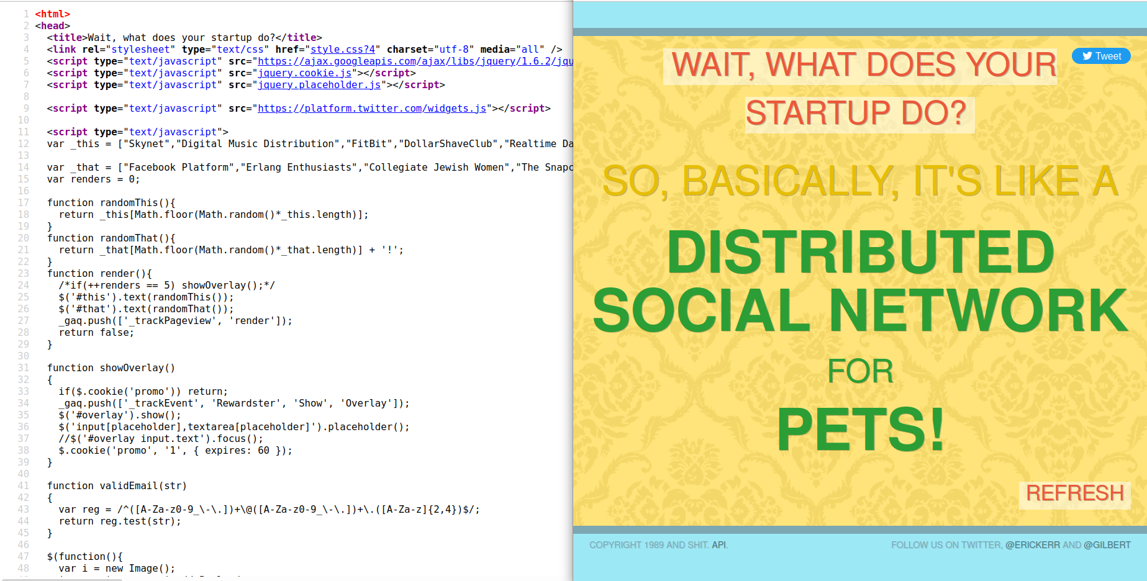
HTML

Slide 41
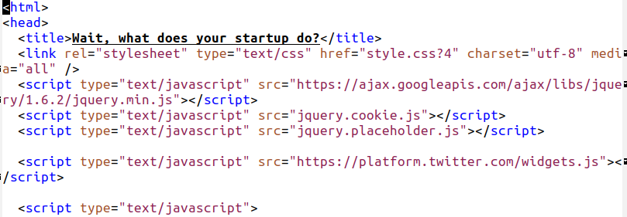
HTML

Slide 42
XML
<note>
<to>Tove</to>
<from>Jani</from>
<heading>Reminder</heading>
<body>Don't forget me this weekend!</body>
</note>

Slide 43
JSON
{"menu": {
"id": "file",
"value": "File",
"popup": {
"menuitem": [
{"value": "New", "onclick": "CreateNewDoc()"},
{"value": "Open", "onclick": "OpenDoc()"},
{"value": "Close", "onclick": "CloseDoc()"}
]
}
}}

Slide 44
Parsing
Parser
HTML, XML, JSON, etc
str, dict, list, pandas.DataFrame, etc.

Slide 45




Slide 46
Next lecture
How do you reuse existing code without copyright infringement?

Slide 47
Next lecture
How do you reuse existing code without copyright infringement?
How to you share your code for the community to benefit from it?

Slide 48
Midterm

Slide 49
Midterm
Up to and including module 9 (file I/O, error handling)

Slide 50
Midterm
Up to and including module 9 (file I/O, error handling)
No Numpy, Matplotlib, HTTP, XML, BeautifulSoup

Slide 51
Midterm
Up to and including module 9 (file I/O, error handling)
No Numpy, Matplotlib, HTTP, XML, BeautifulSoup
Practice questions on Blackboard > Course Content

Slide 52
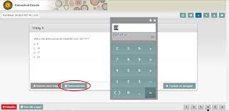
Midterm
Up to and including module 9 (file I/O, error handling)
No Numpy, Matplotlib, HTTP, XML, BeautifulSoup
Practice questions on Blackboard > Course Content
Notes:
Code cannot be run
Not required to write entire programs
Some multiple choice, some open-ended
Mostly questions fundamental principles

Slide 53
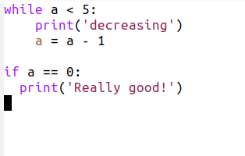
Back-up Slides
Common Project-1 errors: Wooclap questions
Inconsistent indentation
Notes:
Code cannot be run
Not required to write entire programs
Some multiple choice, some open-ended
Mostly questions fundamental principles

Slide 54

Back-up Slides
Common Project-1 errors: Wooclap questions
Inconsistent indentation
Notes:
Code cannot be run
Not required to write entire programs
Some multiple choice, some open-ended
Mostly questions fundamental principles

Slide 55
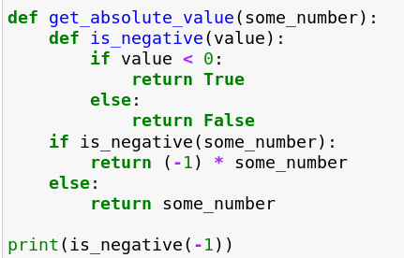
Back-up Slides
Common Project-1 errors: Wooclap questions
Do not use nested functions
Notes:
Code cannot be run
Not required to write entire programs
Some multiple choice, some open-ended
Mostly questions fundamental principles

Slide 56
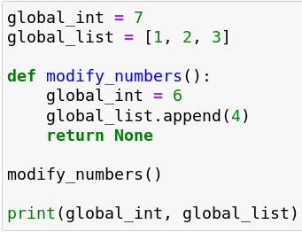
Back-up Slides
Common Project-1 errors: Wooclap questions
Beware of global variables and naming!
Notes:
Code cannot be run
Not required to write entire programs
Some multiple choice, some open-ended
Mostly questions fundamental principles

